Slide 1

The Influence of Training Status On Mechanisms of Rapid Vasodilation In Healthy Adults
Matthew Stanford
A human physiology study using ultrasound, Near InfraRed Spectroscopy (NIRS), and inferential statistics
This study investigated how exercise training status affects chemical, mechanical, and neural mechanisms of forearm rapid vasodilation. Twenty-five subjects completed a standardized stimulation protocol, which assessed forearm blood flow, vascular conductance, and oxygen saturation, using doppler ultrasound, finger photoplethysmography, and NIRS. Intergroup comparisons, conducted using t-tests/non-parametric equivalents, and ANOVAs, reveal distinct differences in vascular response to brief stimuli between forearm trained and sedentary individuals.

Slide 2
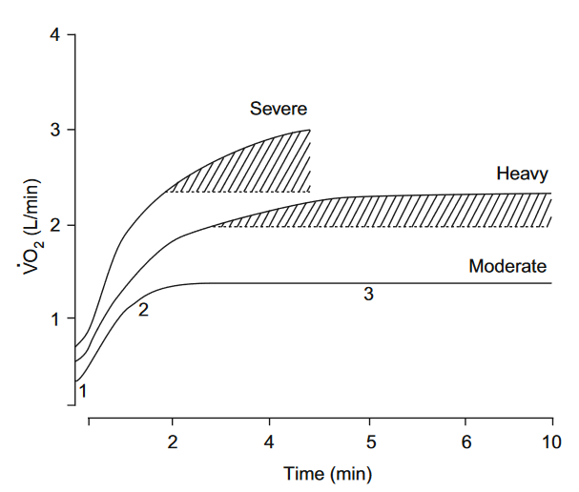
Introduction
Oxidative metabolism is crucial for long-term exercise and relies on an appropriate increase in oxygen supply to match demand to avoid fatigue-onset (Xu & Rhodes, 1999).
An increase in blood flow to working tissue is necessary to match oxygen supply to oxygen demand (Hanson et al., 2021).
(Xu & Rhodes, 1999).
Notes:
(click 1) It is well established by now that oxidative metabolism is important for exercise, particularly long-term exercise, and that an increase in oxygen supply is necessary to match demand.
(click 2) Failure to meet demand increases reliance on anaerobic metabolism, leading to fatigue more rapidly.
(click 3) An increase in BLOOD FLOW to working tissues is necessary to match the oxygen supply to a new, elevated, demand.
This figure on the right is a schematic representing different oxygen-utilization curves over time, at different exercise intensities. (If anyone asks, the shaded region is slow component rise; representing an onset of fatigue at higher intensities). What’s particularly important about this each of these curves is how quickly one can achieve this steady state (point to horizontal lines). The more quickly one can increase blood flow to match the new oxygen demand, the less time spent in oxygen debt.

Slide 3
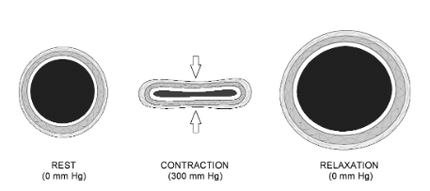
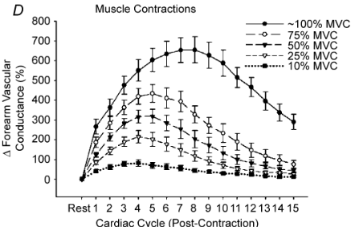

Rapid Vasodilation as an Experimental Model
Q_{a} = $∆$P*VC (Tschakovsky et al., 1996).
  Q_{a} = arterial inflow (blood flow), $∆$P = arterio-venous pressure gradient, VC = vascular (arterial) conductance
Rapid vasodilation (ROV) occurs in response to skeletal muscle contraction or vascular compression (Kirby et al., 2007).
ROV causes a transient increase in resistance vessel diameter (top right figure), increasing vascular conductance (bottom right figure) and, thus, blood flow (see equation above).
Chronic endurance training has been shown to preserve ROV responses in older adults (aged ~60+) compared to old untrained, but these observations may be explained by other factors that are preserved in old age through exercise (Hughes et al., 2016).
  Untrained older adults did not have improved responses compared to young untrained adults.
  Prior to this current study, it was unknown whether exercise training could promote adaptations to ROV in healthy young adults.
(Clifford and Tschakovksy, 2008 (top); Kirby et al., 2007 (bottom)).
Notes:
What we are concerned with today is one specific mechanism to increase blood flow.
(click 1 and 2) One of the simplest ways to illustrate blood flow mechanics is through this equation, where Q sub a is blood flow (arterial inflow in this case), delta P is the arterio-venous pressure gradient, and VC is conductance, or EASE, of flow through the arterial side.
(click 3, 4, 5) Blood flow can be modulated by pressure, conductance, or both. This occurs through several feedback and feedforward mechanisms. One important feedfoward mechanism is known as Rapid Vasodilation. It is also referred to as Rapid Onset Vasodilation, which is why it will be referred to as Rapid Vasodilation or ROV for this presentation.
This figure on the right represents the average time course of change in vascular conductance of 17 subjects at 5 different intensities, relative to their maximal voluntary contraction. In this study, subject lay supine on an observation table, with their arms abducted and supported, to allow them to remain at heart level. They would then be cued to squeeze a custom handgrip device with an external load based on their respective maximal voluntary contractions, for one second. Brachial artery blood flow velocity was measured for atleast 15 seconds following the release of the contraction and used in conjunction with brachial artery diameter, to calculate blood flow.

Slide 4

Study Design Overview – Main Research Question
Main Hypotheses
Trained subjects will display greater peak and total FVC response to a 1-second, voluntary contraction, at both absolute and relative intensities, and to electrically stimulated contractions and external compression at the same absolute stimulus, compared to sedentary counterparts.
Of the 25 subjects who completed the full protocol, 16 subjects were included in final analysis (8 trained, 8 sedentary, matched based on age ($±$ 3 years) and height ($±$ 2.5 cm)).
  2 visits per subject, including 1 experimental visit (see protocol highlighted in purple, below).
1-second stimuli applied to the forearm: voluntary contraction (5 intensities), involuntary contraction via electrical stimulation (2 intensities), mechanical compression (3 intensities).
Randomized, single-blind design.
Forearm blood flow assessed indirectly via ultrasound imaging of the brachial artery, mean arterial pressure assessed using finger photoplethysmography, forearm tissue oxygen saturation assessed locally using a wired NIRS probe.
Instrumentation 20 min | Rest 5 min | Randomized Stimuli Trial 1 20 min | Rest ~2-3 min | Randomized Stimuli Trial 2 20 min | Re-Instrumentation ~10 min
Rest 5 min | Mitochondrial Function ~7 min | Rest 15 min | Pre-Critical Force Contractions 3 min | Critical Force Test 10 min

Slide 5
Study Design Overview – Mitochondrial Function and Critical Force
Forearm skeletal muscle oxygenation was measured continuously via NIRS in the flexor digitorum profundus of the non-dominant arm (see protocol highlighted in purple, below).
Mitochondrial function: Subjects performed brief bout of maximal forearm exercise (0.5sec contract, 0.5sec relax; 15 sec), followed by a series of cuff occlusions at a pressure of 230mmHg, in the order below: occlusion numbers ; inflation (sec)/deflation (sec) (Rosenberry et al., 2018; Ryan et al., 2013).
  1-6 ; 5/5
  7-10 ; 7/10
  11-14 ; 10/15
  15-18 ; 10/20
Pre-critical force contractions: Subjects performed 3, maximal, handgrip contractions for 1 second each, separated by 1 minute each.
Critical force test: A 10-minute, maximal effort forearm-critical force test was performed following completion of the pre-critical force stage (Kellawan & Tschakovsky, 2014).
  Subjects performed 200 MVCs at a rate of 1 second contraction, 2 second rest (totaling 10 minutes).
Instrumentation 20 min | Rest 5 min | Randomized Stimuli Trial 1 20 min | Rest ~2-3 min | Randomized Stimuli Trial 2 20 min | Re-Instrumentation ~10 min
Rest 5 min | Mitochondrial Function ~7 min | Rest 15 min | Pre-Critical Force Contractions 3 min | Critical Force Test 10 min

Slide 6
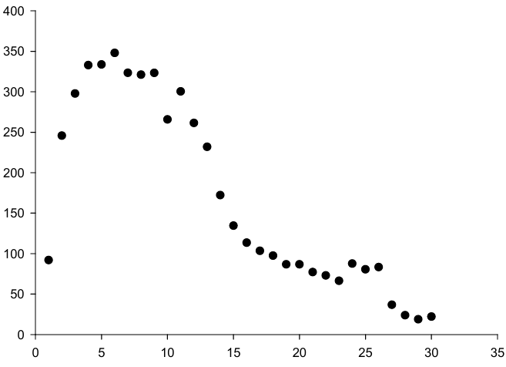
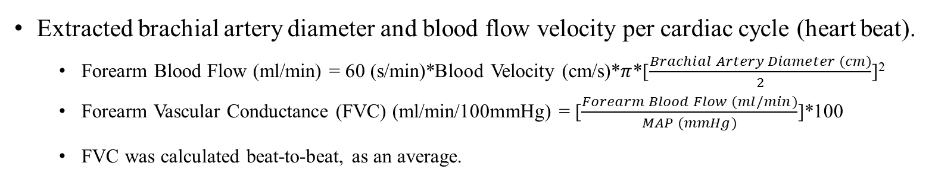


Measurement and Processing - ROV
Extracted brachial artery diameter and blood flow velocity per cardiac cycle (heart beat).
  Forearm Blood Flow (ml/min) = 60 (s/min)*Blood Velocity (cm/s)*$π$*[$\frac{Brachial Artery Diameter (cm)}{2}$]²
  Forearm Vascular Conductance (FVC) (ml/min/100mmHg) = [$\frac{Forearm Blood Flow (ml/min)}{MAP (mmHg)}$]*100
  FVC was calculated beat-to-beat, as an average.
∆FVC = FVC- FVCrestAVG
  $∆$FVC reported was the average across the 2 trials for each subject.
  Processed first 30 cardiac cycles, post stimulus, averaged last 30 cardiac cycles pre stimulus.
  $∆$FVC_{total} = AUC$∆$_{FVC} over 30 cardiac cycles immediately post stimulus.
  $∆$FVC_{peak} = Largest $∆$FVC observed within 30 cardiac cycles immediately post stimulus.
  Chemical+Mechanical Contribution to (15kg or MVC) ∆FVC_{total} = $\left[\frac{∆FVCtotal(10mA)}{∆FVCtotal(15kg or MVC)}\right]$*100
  Mechanical Contribution to 10mA $∆$FVC_{total} = $\left[\frac{∆FVCtotal\left(300mmHg\right)}{∆FVCtotal(10mA)}\right]$*100
$∆$FVC (ml/min/100mmHg)
Cardiac Cycles

Slide 7
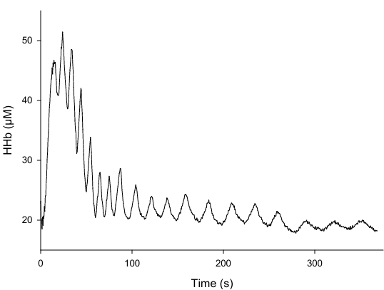
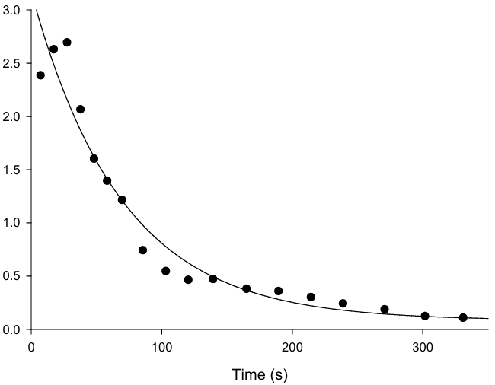
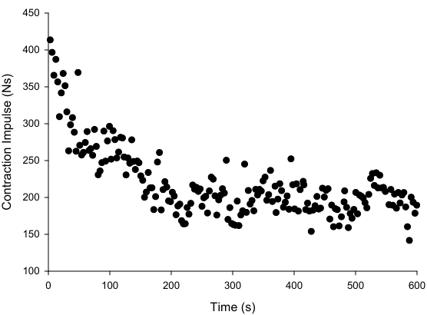
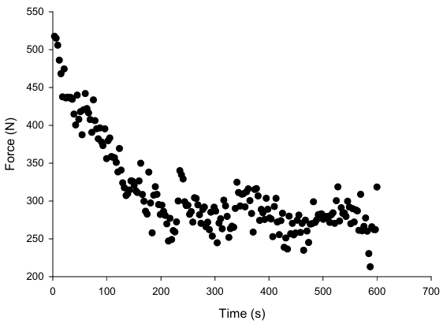
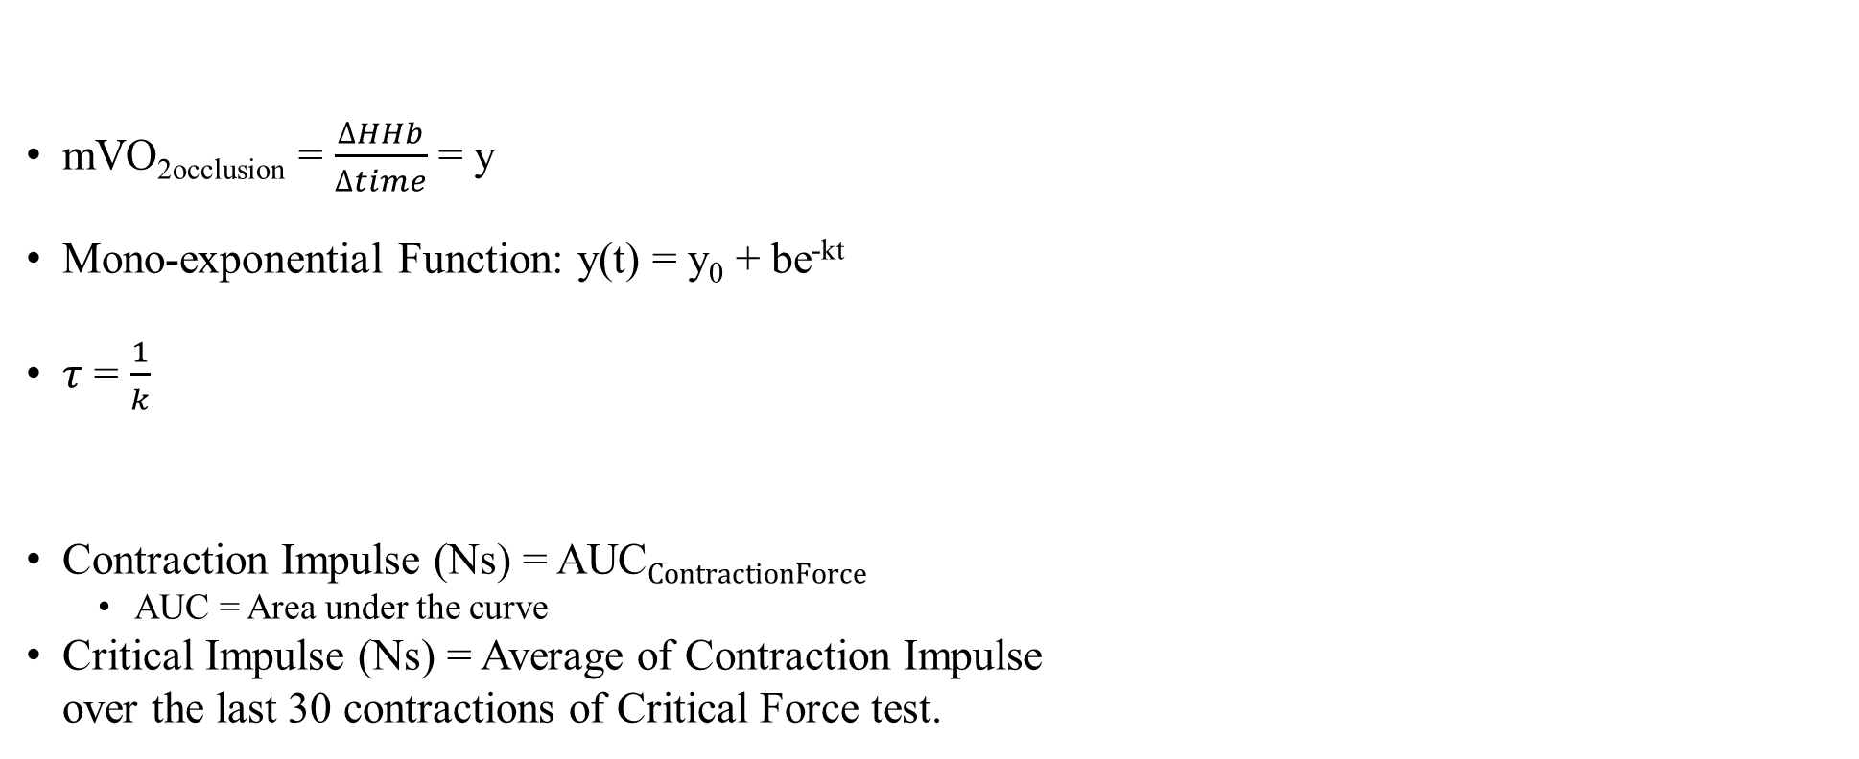

Measurement and Processing – Mitochondrial Function and Critical Force
mVO_{2occlusion} = $\frac{∆HHb}{∆time}$ = y
Mono-exponential Function: y(t) = y₀ + be^{-kt}
$τ$ = $\frac{1}{k}$
Contraction Impulse (Ns) = AUC$\text{C}\text{ontractionForce}$
  AUC = Area under the curve
Critical Impulse (Ns) = Average of Contraction Impulse
over the last 30 contractions of Critical Force test.
$∆$HHb/$∆$s
Contraction Force (N)
(Ryan et al., 2012).

Slide 8
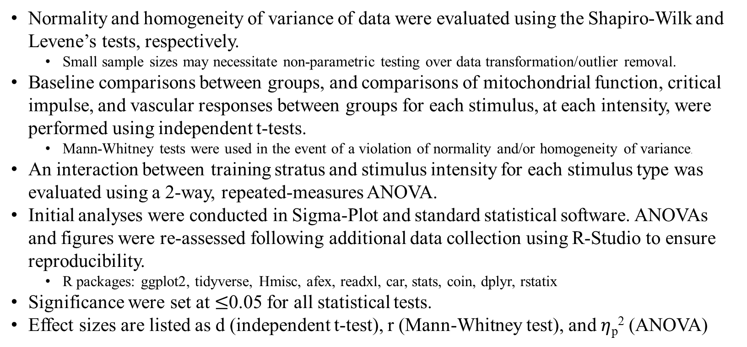
Statistical Analysis
Normality and homogeneity of variance of data were evaluated using the Shapiro-Wilk and Levene’s tests, respectively.
  Small sample sizes may necessitate non-parametric testing over data transformation/outlier removal.
Baseline comparisons between groups, and comparisons of mitochondrial function, critical impulse, and vascular responses between groups for each stimulus, at each intensity, were performed using independent t-tests.
  Mann-Whitney tests were used in the event of a violation of normality and/or homogeneity of variance.
An interaction between training stratus and stimulus intensity for each stimulus type was evaluated using a 2-way, repeated-measures ANOVA.
Initial analyses were conducted in Sigma-Plot and standard statistical software. ANOVAs and figures were re-assessed following additional data collection using R-Studio to ensure reproducibility.
  R packages: ggplot2, tidyverse, Hmisc, afex, readxl, car, stats, coin, dplyr, rstatix
Significance were set at $≤$0.05 for all statistical tests.
Effect sizes are listed as d (independent t-test), r (Mann-Whitney test), and $η$_{p}² (ANOVA)

Slide 9
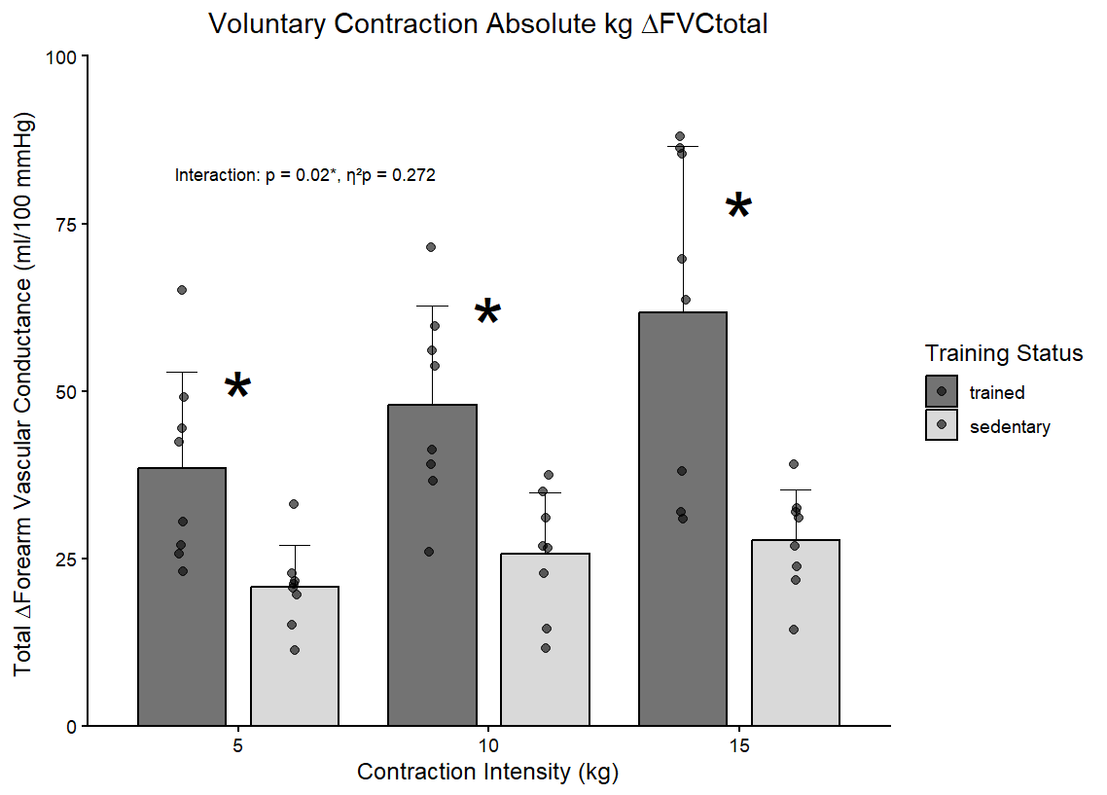
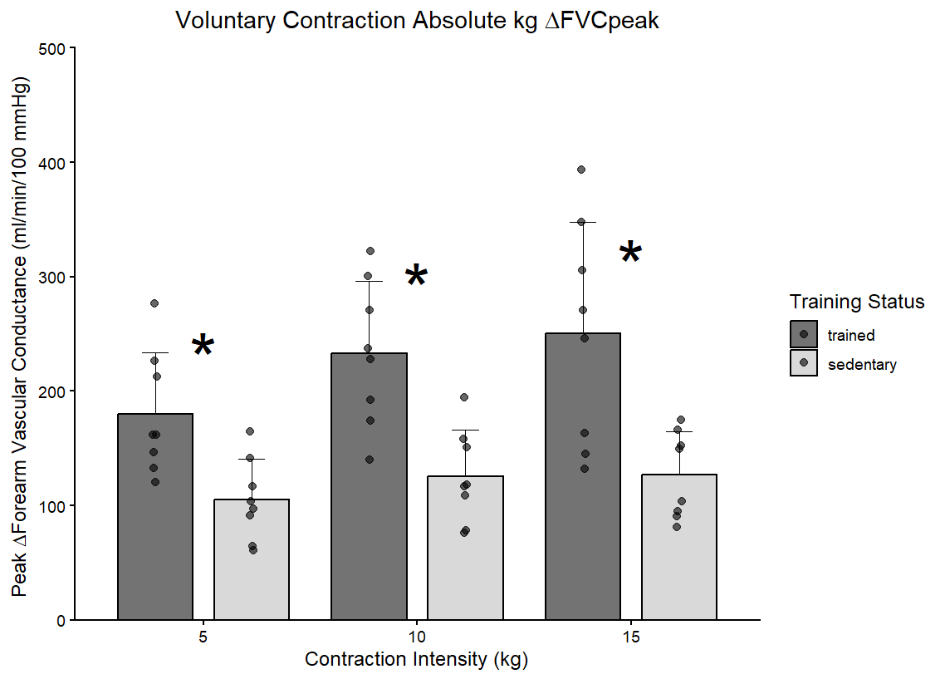
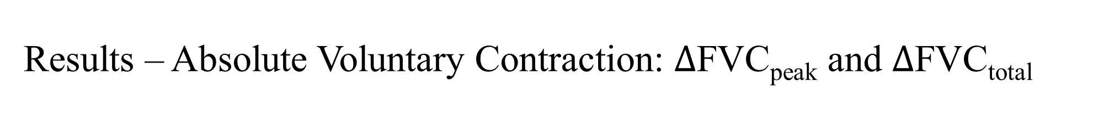
Results – Absolute Voluntary Contraction: $∆$FVC_{peak} and $∆$FVC_{total}
Trained subjects displayed enhanced ROV responses across all conditions compared to sedentary counterparts.
* Indicates significance between groups at a specific intensity level.
Notes:
There was also a significant interaction between training status and stimulus intensity with absolute resistances for voluntary contraction. Because these resistances are absolute here, this is additional strong evidence of adaptations to ROV based on training status.

Slide 10
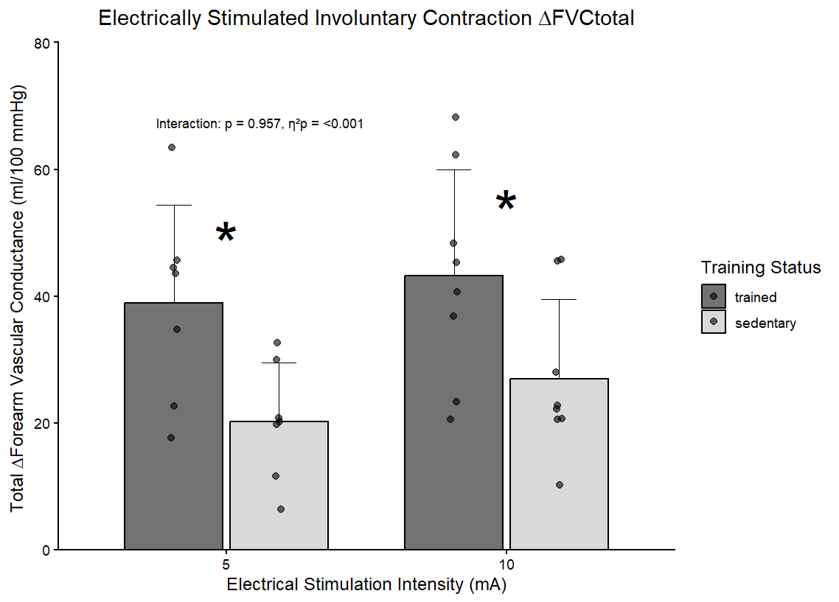
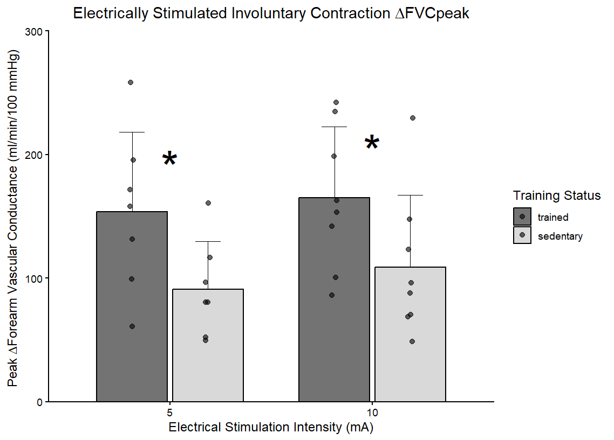

Results – Involuntary Contraction: $∆$FVC_{peak} and $∆$FVC_{total}
Trained subjects displayed enhanced ROV responses across all conditions compared to sedentary counterparts.
Notes:
There was also a significant interaction between training status and stimulus intensity with absolute resistances for voluntary contraction. Because these resistances are absolute here, this is additional strong evidence of adaptations to ROV based on training status.

Slide 11
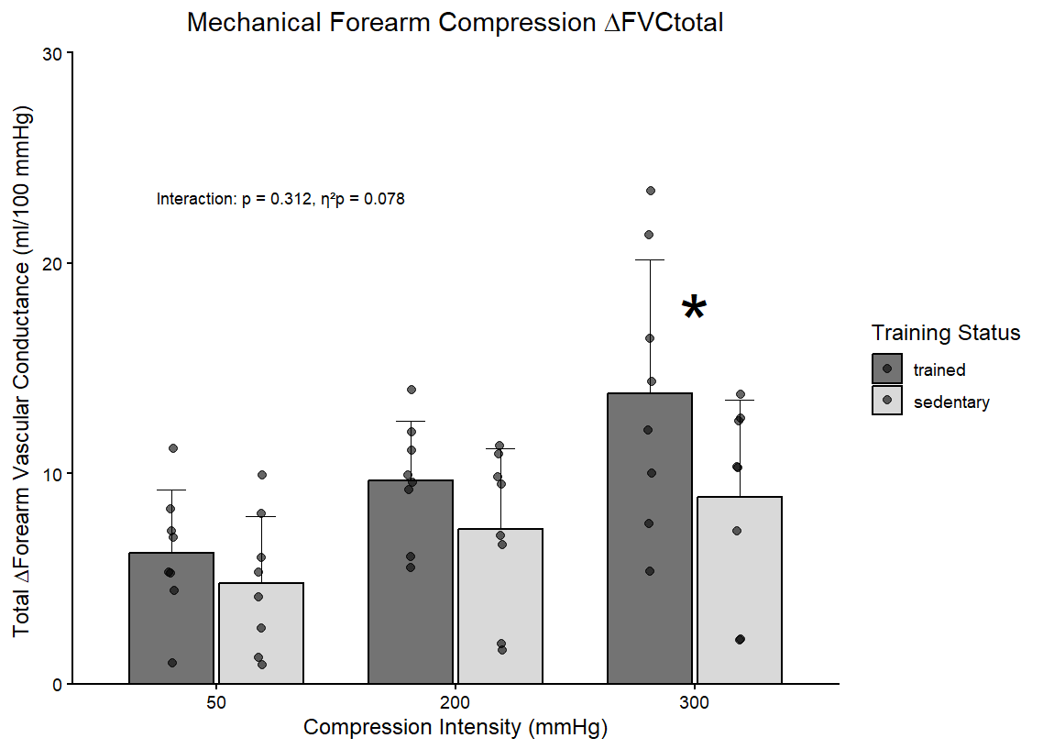
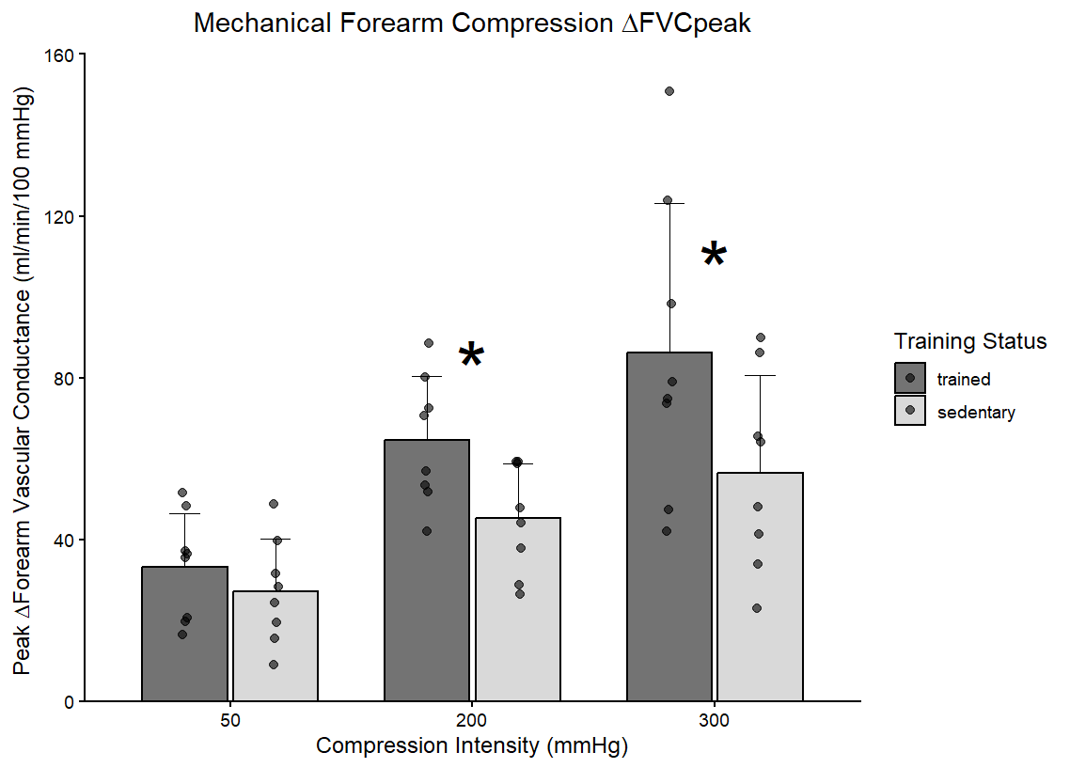

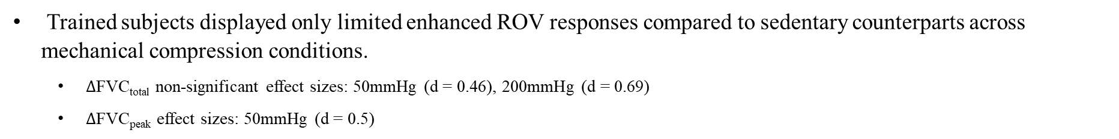
Results – Mechanical Compression: $∆$FVC_{peak} and $∆$FVC_{total} (Exploratory)
Trained subjects displayed only limited enhanced ROV responses compared to sedentary counterparts across mechanical compression conditions.
  $∆$FVC_{total} non-significant effect sizes: 50mmHg (d = 0.46), 200mmHg (d = 0.69)
  $∆$FVC_{peak} effect sizes: 50mmHg (d = 0.5)
Notes:
There was also a significant interaction between training status and stimulus intensity with absolute resistances for voluntary contraction. Because these resistances are absolute here, this is additional strong evidence of adaptations to ROV based on training status.

Slide 12
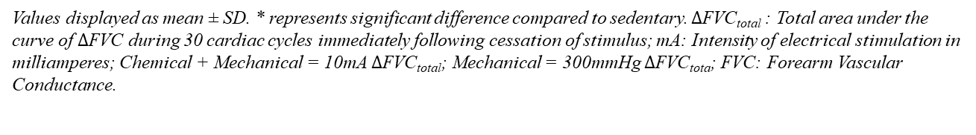
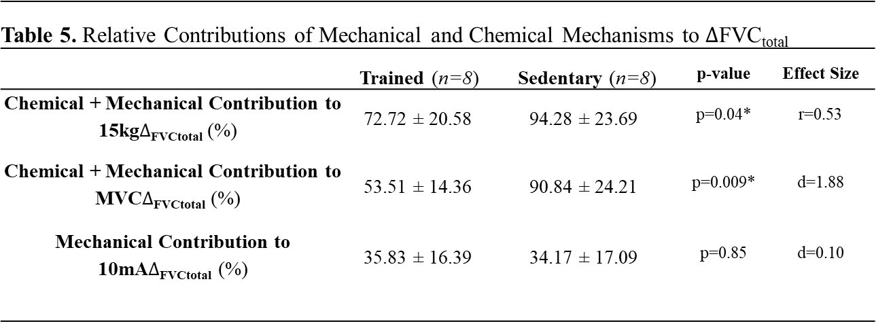
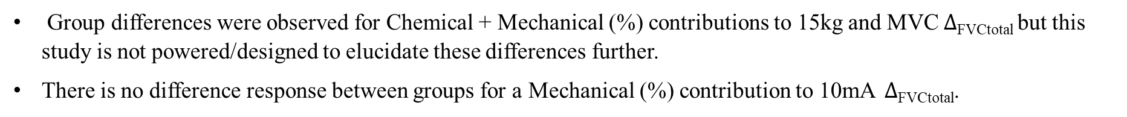
Results – Percent Contributions
Table 5. Relative Contributions of Mechanical and Chemical Mechanisms to $∆$FVC_{total}
 | Trained (n=8) | Sedentary (n=8) | p-value | Effect Size
Chemical + Mechanical Contribution to 15kg$∆$_{FVCtotal} (%) | 72.72 ± 20.58 | 94.28 ± 23.69 | p=0.04* | r=0.53
Chemical + Mechanical Contribution to MVC$∆$_{FVCtotal} (%) | 53.51 ± 14.36 | 90.84 ± 24.21 | p=0.009* | d=1.88
Mechanical Contribution to 10mA$∆$_{FVCtotal} (%) | 35.83 ± 16.39 | 34.17 ± 17.09 | p=0.85 | d=0.10
Values displayed as mean ± SD. * represents significant difference compared to sedentary. $∆$FVC_{total} : Total area under the curve of $∆$FVC during 30 cardiac cycles immediately following cessation of stimulus; mA: Intensity of electrical stimulation in milliamperes; Chemical + Mechanical = 10mA $∆$FVC_{total}; Mechanical = 300mmHg $∆$FVC_{tota}; FVC: Forearm Vascular Conductance.
Group differences were observed for Chemical + Mechanical (%) contributions to 15kg and MVC $∆$_{FVCtotal} but this study is not powered/designed to elucidate these differences further.
There is no difference response between groups for a Mechanical (%) contribution to 10mA $∆$_{FVCtotal}.

Slide 13
Discussion – Mechanistic Interpretation
Trained subjects showed enhanced ROV in all conditions for voluntary and involuntary stimuli compared to sedentary subjects, and some conditions for mechanical compression. Speculative adaptation possibilities include:
  Augmented K⁺ ion handling between smooth and skeletal muscle (K⁺ may play the biggest singular role in the ROV in humans (Crecelius et al., 2013)).
  Increased Nitric Oxide (NO) availability. NO has also demonstrated a meaningful role in ROV in humans, and chronic exercise has shown to increase NO bioavailability and signaling in healthy humans (Casey et al., 2013; Goto et al., 2003; Hambrecht et al., 2003).
  Neural contributions are less clear from this study.
Mechanical-only conditions demonstrate more limited evidence for ROV adaptation in this study.
  When considered as a proportion of the chemical + mechanical response, there is very minimal group difference.

Slide 14
Discussion – Limitations
Training status was determined via self-reported training and general activity level on the IPAQ.
  Strict inclusion criteria for the sedentary group helps to compensate for possible imprecision in self-reporting in the trained group.
Our lab equipment for mechanical compression, although aligned with current research, differed significantly from Kirby et al. (2007).
We did not measure contraction force or intramuscular pressure from electrical stimulation or voluntary contraction.
  Prior evidence suggests a linear relationship with ROV and contraction intensity (Kirby et al., 2007). It is possible there could be interindividual variation in these variables during the same intensity electrical stimulation or voluntary contraction against an absolute amount of resistance.
This study accounted for obesity, not adiposity.
  Limited evidence suggests adiposity is inversely related to ROV (Blain et al., 2012).
This study was not powered for a sex comparison.
  Limited evidence suggests there is not a sex difference for absolute intensities of contraction in healthy young adults, but is worth exploring with consideration for training status (Hanson et al., 2021).

Slide 15
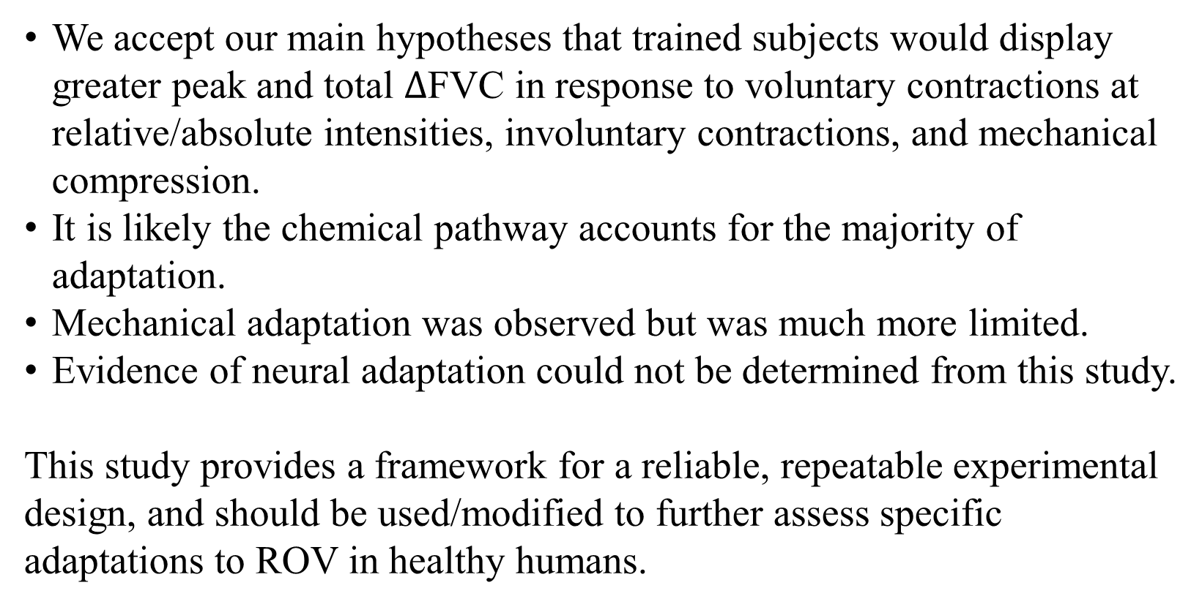
Conclusion
We accept our main hypotheses that trained subjects would display greater peak and total $∆$FVC in response to voluntary contractions at relative/absolute intensities, involuntary contractions, and mechanical compression.
It is likely the chemical pathway accounts for the majority of adaptation.
Mechanical adaptation was observed but was much more limited.
Evidence of neural adaptation could not be determined from this study.
This study provides a framework for a reliable, repeatable experimental design, and should be used/modified to further assess specific adaptations to ROV in healthy humans.

Slide 16
Data Science/Analytics Skills
Experimental design and human subject data acquisition
  Pre-study power analysis performed to estimate likely sample size needed.
  Adherence to institutional and ethical regulations for subject protection (institutional review board documentation, HIPAA).
Inferential statistics and interpretation (independent t-tests and non-parametric equivalents, Pearson and Spearman-rank correlation coefficients, ANOVA, effect size)
R-Studio code for reproducible figure generation
Interpretation and modeling of non-linear physiological phenomena
Scientific communication and lab leadership/training

Slide 17
References
Blain, G. M., Limberg, J. K., Mortensen, G. F., & Schrage, W. G. (2012). Rapid onset vasodilatation is blunted in obese humans. Acta Physiologica (Oxford, England), 205(1), 103–112. https://doi.org/10.1111/j.1748-1716.2011.02370.x
Casey, D. P., Walker, B. G., Ranadive, S. M., Taylor, J. L., & Joyner, M. J. (2013). Contribution of nitric oxide in the contraction-induced rapid vasodilation in young and older adults. Journal of Applied Physiology (Bethesda, Md.: 1985), 115(4), 446–455. https://doi.org/10.1152/japplphysiol.00446.2013
Crecelius, A. R., Kirby, B. S., Luckasen, G. J., Larson, D. G., & Dinenno, F. A. (2013). Mechanisms of rapid vasodilation after a brief contraction in human skeletal muscle. American Journal of Physiology - Heart and Circulatory Physiology, 305(1), H29–H40. https://doi.org/10.1152/ajpheart.00298.2013
Goto, C., Higashi, Y., Kimura, M., Noma, K., Hara, K., Nakagawa, K., Kawamura, M., Chayama, K., Yoshizumi, M., & Nara, I. (2003). Effect of Different Intensities of Exercise on Endothelium-Dependent Vasodilation in Humans. Circulation, 108(5), 530–535. https://doi.org/10.1161/01.CIR.0000080893.55729.28
Hambrecht, R., Adams, V., Erbs, S., Linke, A., Kränkel, N., Shu, Y., Baither, Y., Gielen, S., Thiele, H., Gummert, J. F., Mohr, F. W., & Schuler, G. (2003). Regular Physical Activity Improves Endothelial Function in Patients With Coronary Artery Disease by Increasing Phosphorylation of Endothelial Nitric Oxide Synthase. Circulation, 107(25), 3152–3158. https://doi.org/10.1161/01.CIR.0000074229.93804.5C
Hanson, B. E., Joyner, M. J., & Casey, D. P. (2021). Sex-related differences in rapid-onset vasodilation: Impact of aging. Journal of Applied Physiology, 130(1), 206–214. https://doi.org/10.1152/japplphysiol.00663.2020
Hughes, W. E., Kruse, N. T., & Casey, D. P. (2018). Age-associated impairments in contraction-induced rapid-onset vasodilatation within the forearm are independent of mechanical factors. Experimental Physiology, 103(5), 728–737. https://doi.org/10.1113/EP086908
Hughes, W. E., Ueda, K., & Casey, D. P. (2016). Chronic endurance exercise training offsets the age-related attenuation in contraction-induced rapid vasodilation. Journal of Applied Physiology, 120(11), 1335–1342. https://doi.org/10.1152/japplphysiol.00057.2016
Kirby, B. S., Carlson, R. E., Markwald, R. R., Voyles, W. F., & Dinenno, F. A. (2007). Mechanical influences on skeletal muscle vascular tone in humans: Insight into contraction-induced rapid vasodilatation. The Journal of Physiology, 583(3), 861–874. https://doi.org/10.1113/jphysiol.2007.131250
Rosenberry, R., Chung, S., & Nelson, M. D. (2018). Skeletal Muscle Neurovascular Coupling, Oxidative Capacity, and Microvascular Function with “One Stop Shop” Near-infrared Spectroscopy. Journal of Visualized Experiments : JoVE, 132, 57317. https://doi.org/10.3791/57317
Ryan, T. E., Brizendine, J. T., & McCully, K. K. (2013). A comparison of exercise type and intensity on the noninvasive assessment of skeletal muscle mitochondrial function using near-infrared spectroscopy. Journal of Applied Physiology, 114(2), 230–237. https://doi.org/10.1152/japplphysiol.01043.2012
Ryan, T. E., Brophy, P., Lin, C.-T., Hickner, R. C., & Neufer, P. D. (2014). Assessment of in vivo skeletal muscle mitochondrial respiratory capacity in humans by near-infrared spectroscopy: A comparison with in situ measurements. The Journal of Physiology, 592(Pt 15), 3231–3241. https://doi.org/10.1113/jphysiol.2014.274456
Tschakovsky, M. E., Shoemaker, J. K., & Hughson, R. L. (1996). Vasodilation and muscle pump contribution to immediate exercise hyperemia. American Journal of Physiology-Heart and Circulatory Physiology, 271(4), H1697–H1701. https://doi.org/10.1152/ajpheart.1996.271.4.H1697
Xu, F., & Rhodes, E. C. (1999). Oxygen Uptake Kinetics During Exercise. Sports Medicine, 27(5), 313–327. https://doi.org/10.2165/00007256-199927050-00003

